Slide 1
Vinosaurus
Sophia Li

Slide 2
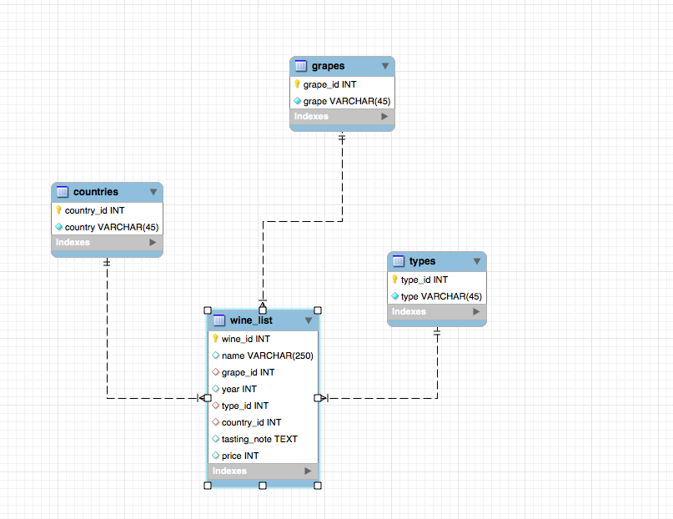
IntRo
Wine Database
Search by:
Name
Year
Type
Grapes
Country
Tasting Notes
Price
Create personalized wine lists

Slide 3
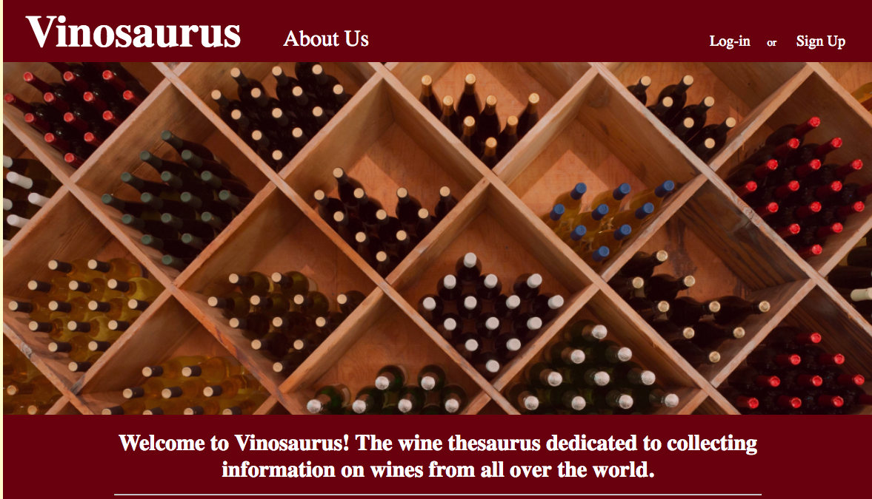
Walk-Through

Slide 4

Thank You!

